Slide 1

Python implementation of Gaussian Plume model
Dr. R. Bloem

Slide 2
Four step process
Import data
From different files
Parse data
Put everything in the right place
Calculation
Export results
In between values can be changed as required

Slide 3
Vans, farms, ships…
Numerical Python (NUMPY)
Numpy does matrix calculations, a bit comparable to Matlab
You can do calculations of
> Two numbers
> A number and an array
> Two arrays of the same length
For example: location of the source times the location of the measurement
Take-away:
Data is either a number, or is an array with length of the number of data points
Source = 2
Measurement = 10
Source * Measurement = 20
Source = numpy.array([1,2,3])
Measurement = 10
Source * Measurement = [10,20,30]
Source = 2
Measurement = numpy.array([10,100,1000])
Source * Measurement = [20,200,2000]
Source = numpy.array([1,2,3])
Measurement = numpy.array([10,100,1000])
Source * Measurement = [10,200,3000]

Slide 4
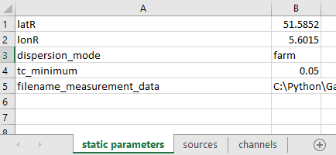
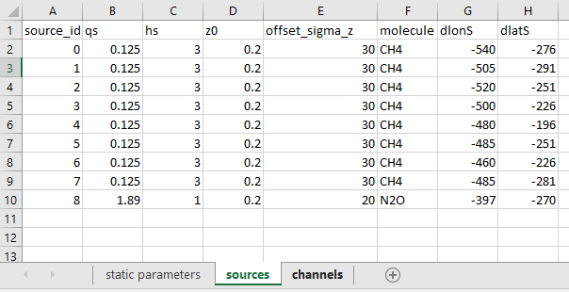
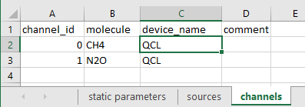
Data files
Measurement data
Data points
Either in csv or Excel
Dynamic parameters
See next slide
Static parameters
Things that don’t change during the measurement
Sources
An overview of the sources (doesn’t change during measurement)
Channels
A measurement channel
A device can have multiple channels
Different channels can measure the same molecule
Array
Number
2 CH4 MIRA

Slide 5
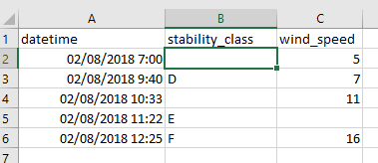
Dynamic parameters
(to be finalized)
Parameters that change irregularly
For example: stack height of a ship
Stability_class and wind_speed were used for testing but are bad examples
Is added to measurement data
Values are repeated until the next change, no interpolation
If a value is missing, the previous value is used
If there is no previous value, it is Not-A-Number (for example between 7 and 9:40 for stability_class)
Can be used for weather data, but it may be better to do make something that interpolates data
Interpreted as
NaN
D
11

Slide 6
Which parameters go where?
For every parameter, the program will look in the measurement data and/or the source table and/or static parameters, …
There is an Excel with an overview
More is possible
For example: location of the measurement (latM, lonM):
“Measurement data”: when the measurement location is changing
“Static parameters”: when the measurement location is static
For example: location of the source:
“Measurement data” as latSX, lonSX: when source X moves
“Sources” under latS, lonS: when the source is not moving
“Measurement data” as latS, lonS: fall-back option when the source(s) move(s).
It should be possible to define some sources in measurement data and others in sources, but this needs to be tested.
Parameters can be in different places
Highly advisable: give every parameter once

Slide 7
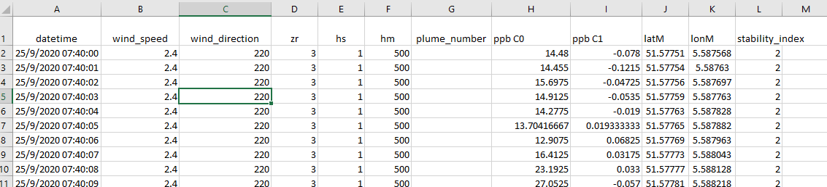
Example: farms
Straightforward

Slide 8
Example: ships
Measurement position: in static parameters
Source:
You can reuse a source for different ships
You can make different sources
Source:
Position: in measurement data (as latS, lonS, or as latSX, lonSX)
Stack height: in dynamic parameters?

Slide 9
Details 1
The concentration is NaN when:
Values are missing
> Exception: plume_number, missing values are set to 0
When dx < 0
There is a warning when some distances is more than 100 km:
Source and measurement
Source and reference
Measurement and reference
Data smoothing is not implemented (yet?)
Time shift due to measurement delay is not implemented (yet?)
Calculation is done for all data, after which the data can be extracted per plume/source
1 location emits two compounds → define two different sources

Slide 10
Details 2
All measurements are done at the same location

Slide 11

Thank you for
Your time

Slide 12
Basis of the implementation
Model is build in Python, using the Numpy and Pandas modules
Numpy does matrix calculations, a bit comparable to Matlab
You can do calculations of
> Two numbers
> A number and an array
> Two arrays of the same length
For example: location of the source times the location of the measurement
Now we only need to get the right data in the right place
Pandas is bit comparable to Origin
Mostly used for importing/exporting
Source = 2
Measurement = 10
Source * Measurement = 20
Source = numpy.array([1,2,3])
Measurement = 10
Source * Measurement = [10,20,30]
Source = 2
Measurement = numpy.array([10,100,1000])
Source * Measurement = [20,200,2000]
Source = numpy.array([1,2,3])
Measurement = numpy.array([10,100,1000])
Source * Measurement = [10,200,3000]

